Slide 1
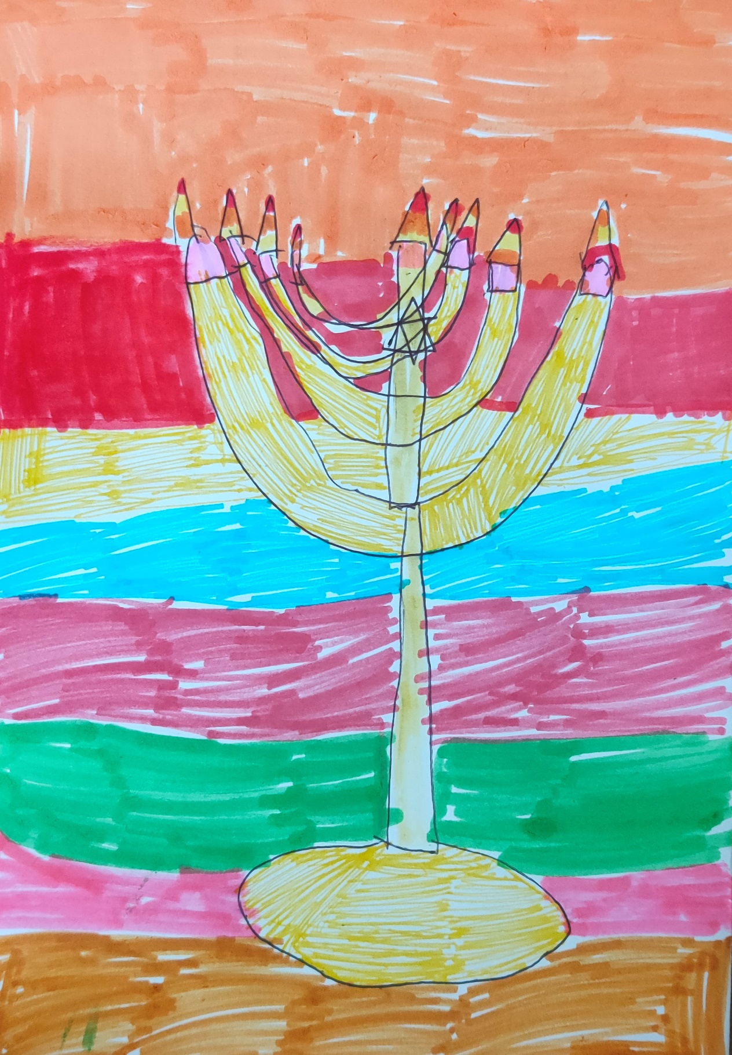
Hanuka
Family activities and visual story
Light over darkness.
To re-dedicate, to purify.
Contact Gil Dekel
PoeticMind.co.uk
Drawing ‘Hanukiya’ by Nicole Dekel. Used with the artist’s permission.

Slide 2
How to use this resource:
Some slides illustrate the Hanuka story, and other slides provide art activities.
Permission to use:
You can use this resource for educational, non-commercial purpose. Credit: © Gil Dekel www.PoeticMind.co.uk
Drawing ‘Hanukiya’ by Nicole Dekel. Used with the artist’s permission.

Slide 3
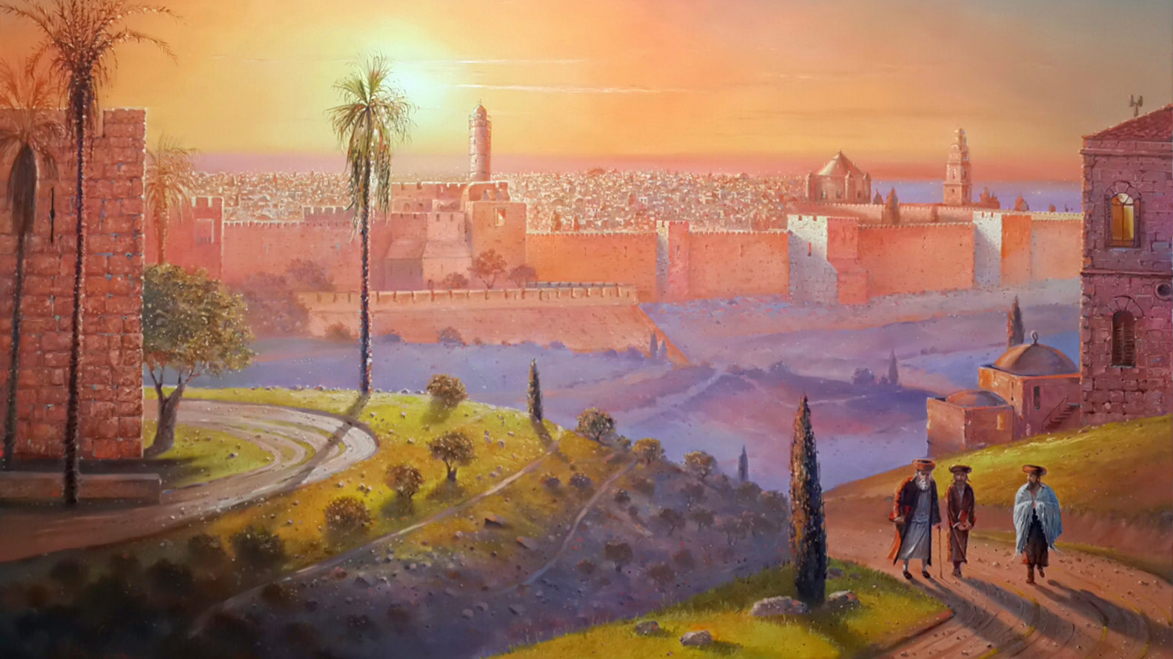
YeruShaLayim
Jerusalem ירושלים
Painting ‘City of Light’ (detail) by Alex Levin https://artlevin.com Used with the artist’s permission.

Slide 4
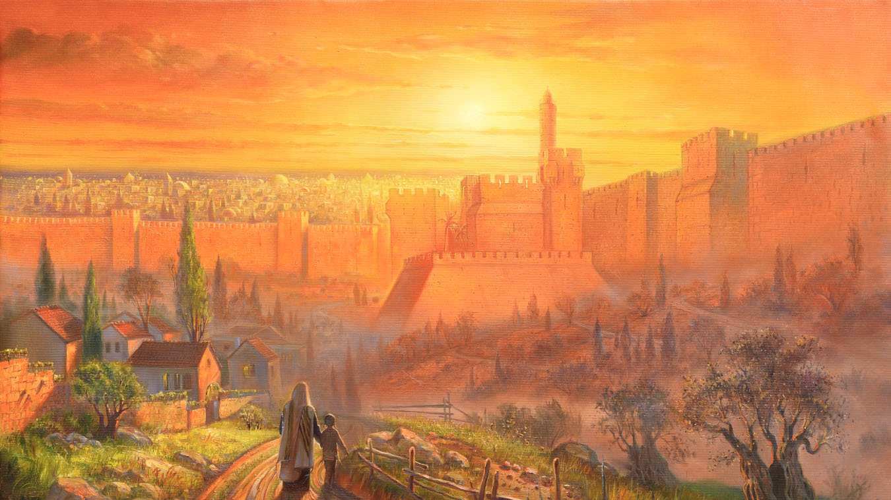
Painting ‘Golden Jerusalem’ (detail) by Alex Levin https://artlevin.com Used with the artist’s permission.

Slide 5
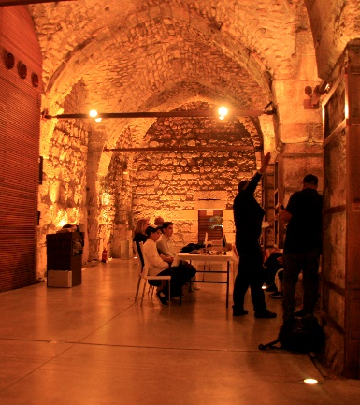
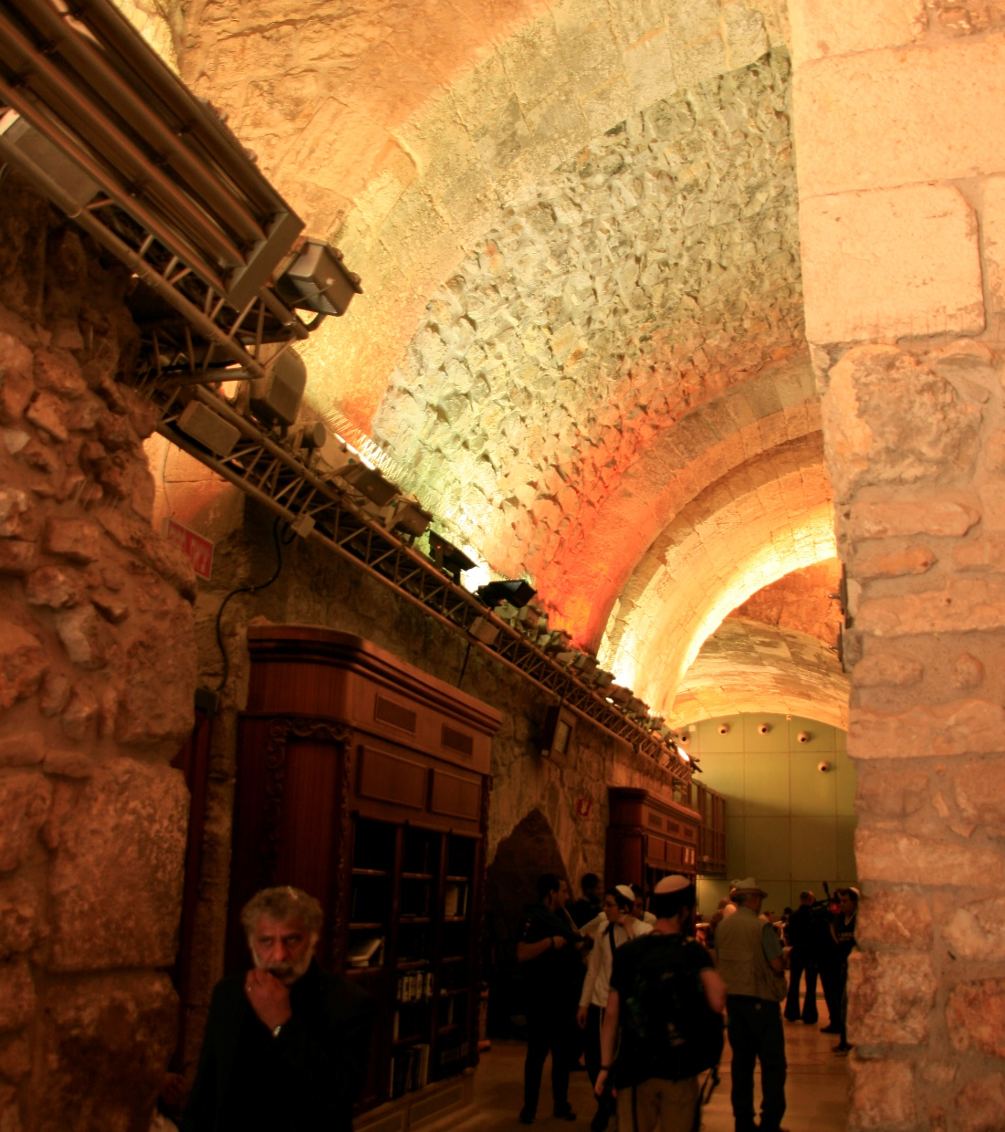
Jerusalem. Photos: © Gil Dekel, 2019.

Slide 6
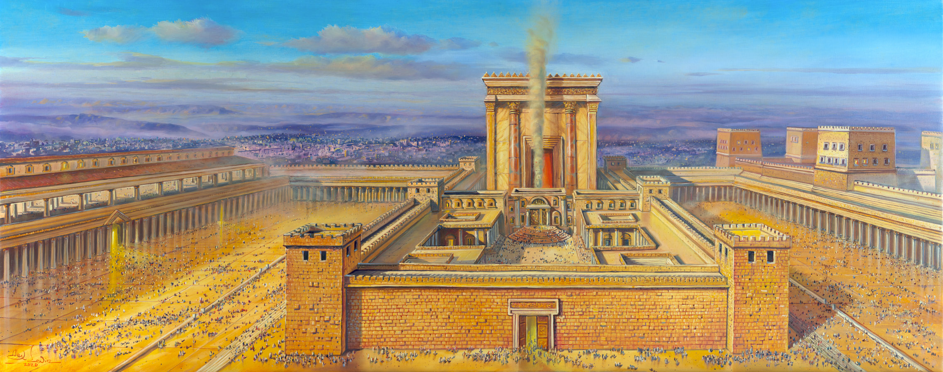
Second Temple, 515 BCE – 70 CE
Painting ‘Temple – The Soul of Jerusalem’ by Alex Levin https://artlevin.com Used with the artist’s permission.

Slide 7
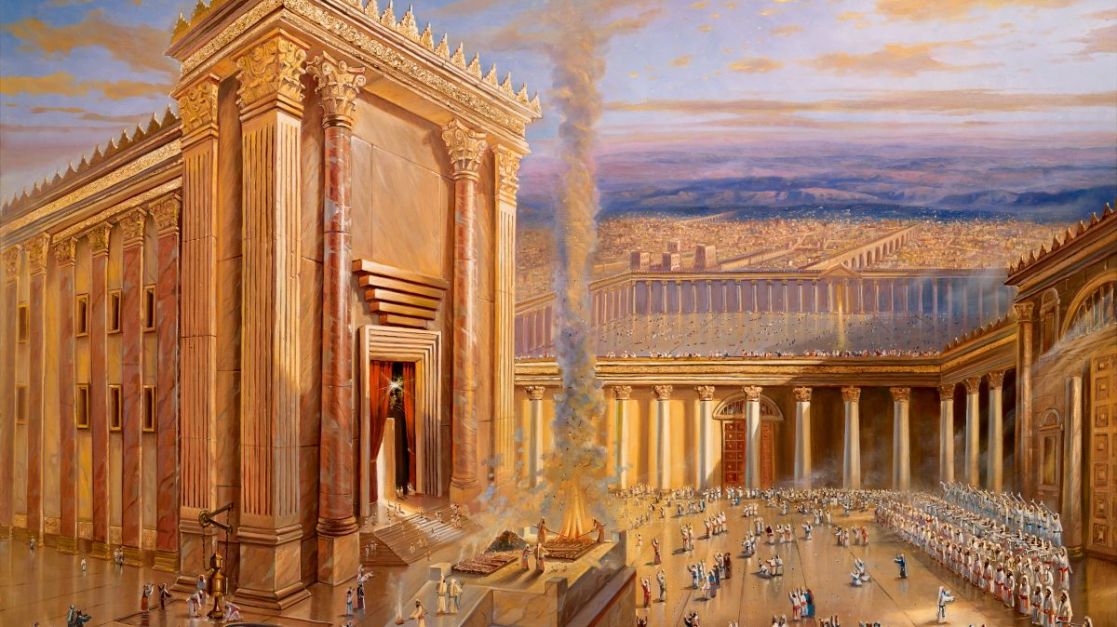
Beit HaMikdash HaSheni
The Soul of Jerusalem
Jerusalem. Painting ‘The Second Jewish Temple’ (detail) by Alex Levin https://artlevin.com Used with the artist’s permission.

Slide 8
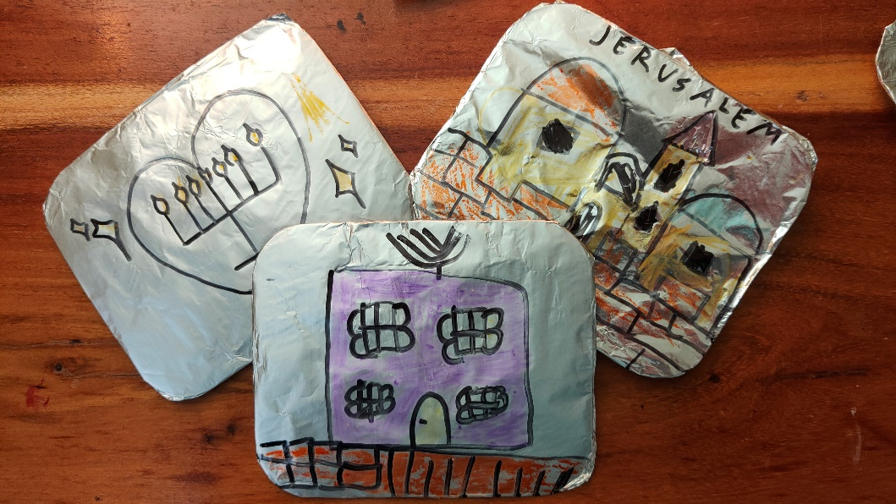
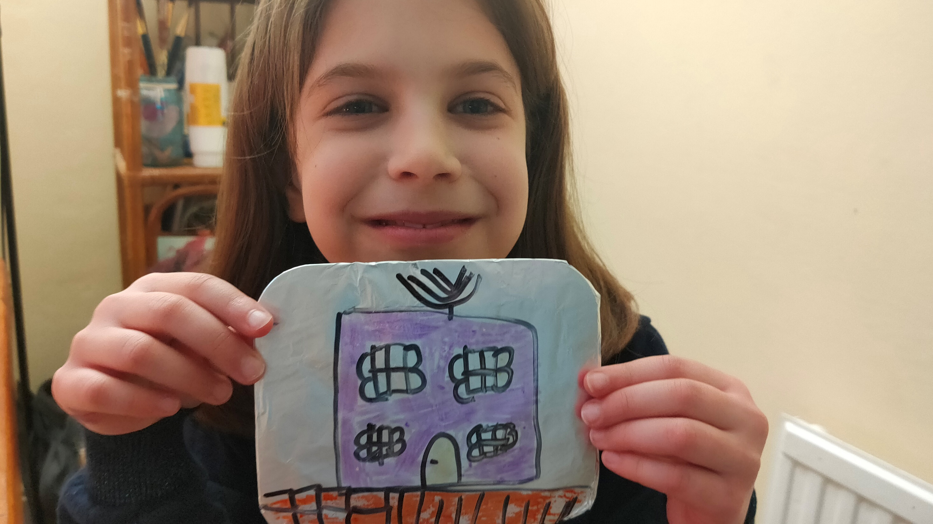
Art Activity
Draw the temple and scenes from Jerusalem on kitchen foil (draw on the side of foil which is not shiny). Photos: © Gil Dekel, 2021.

Slide 9
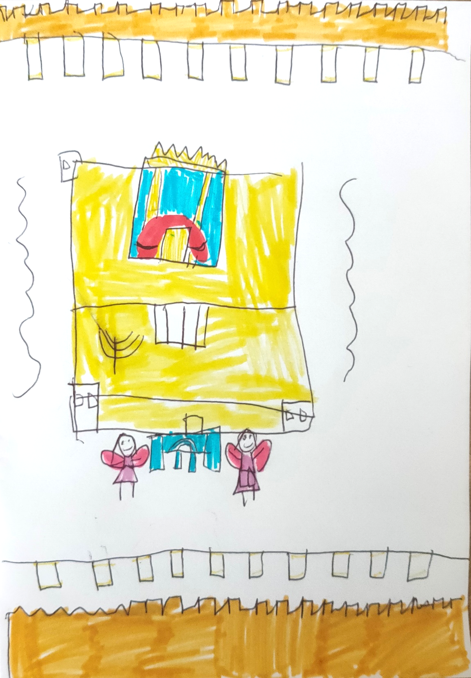
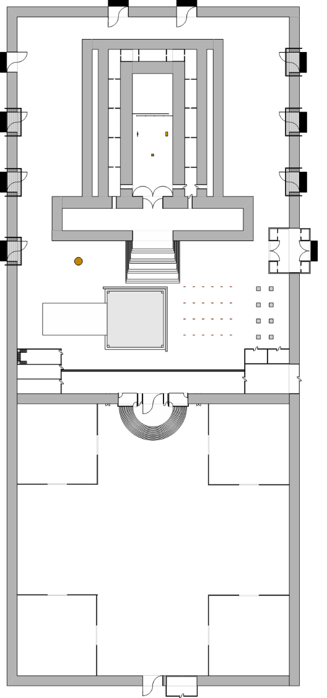
Art Activity
Draw the Temple, art activity. Art: © Nicole Dekel. Diagram of the Temple: https://en.wikipedia.org/wiki/Temple_in_Jerusalem#/media/File:Temple_sketch2.png

Slide 10
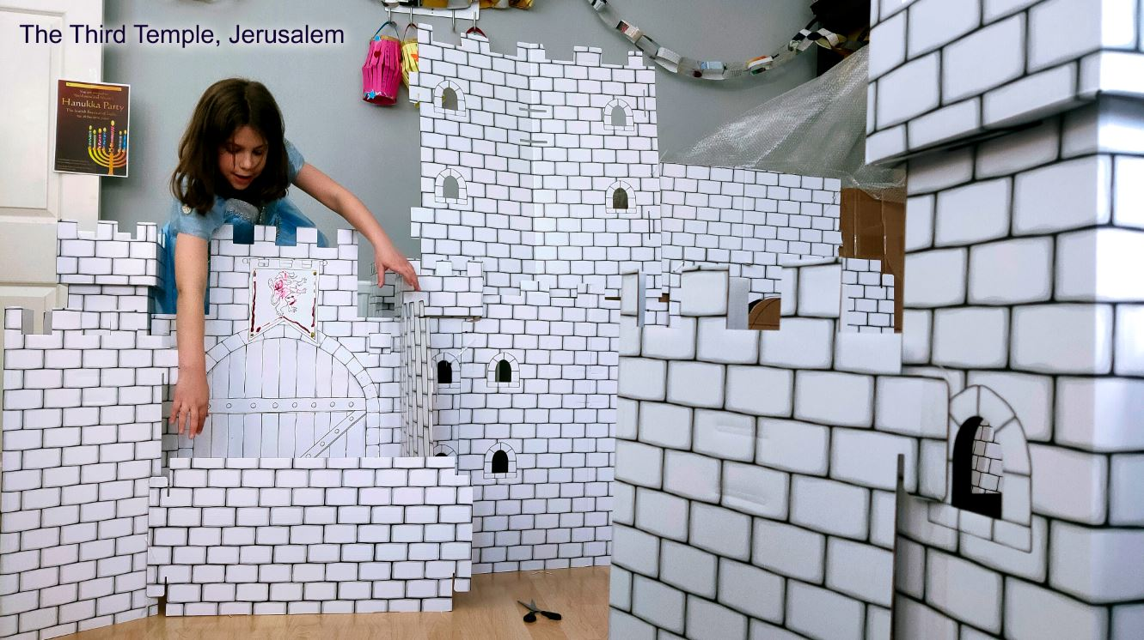
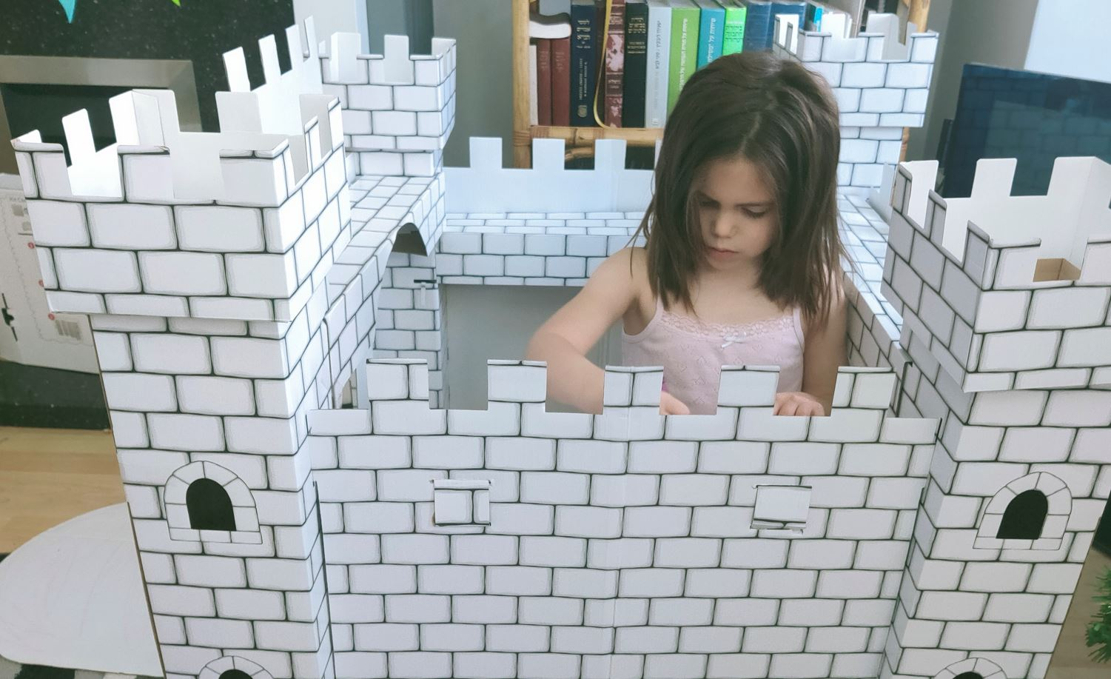
Art Activity
Build the Third Temple. We bought this cardboard castle online. Photos: © Gil Dekel, 2021.

Slide 11
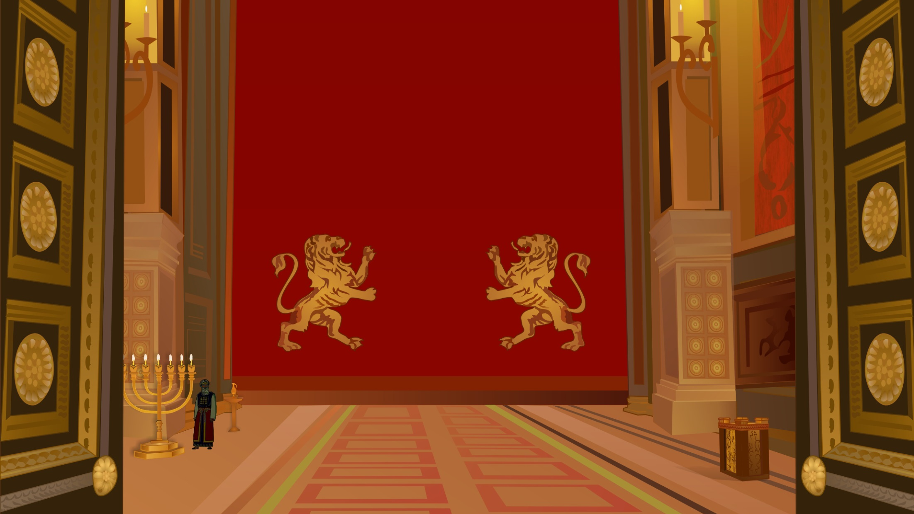
Holy of Holiest (Kodesh HaKoDashim)
Menora
7 branches
Lit with oil
Image © Gil Dekel
Temple ‘Beit Mikdash’, main hall. Art: © Gil Dekel.

Slide 12
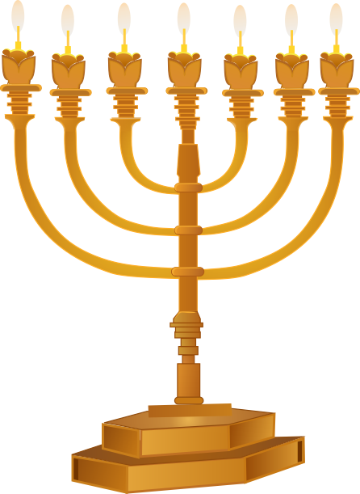
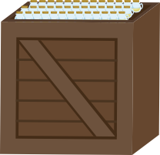
Menora
7 branches
Lit with oil
Temple ‘Beit Mikdash’ Menora. Art: © Gil Dekel.

Slide 13
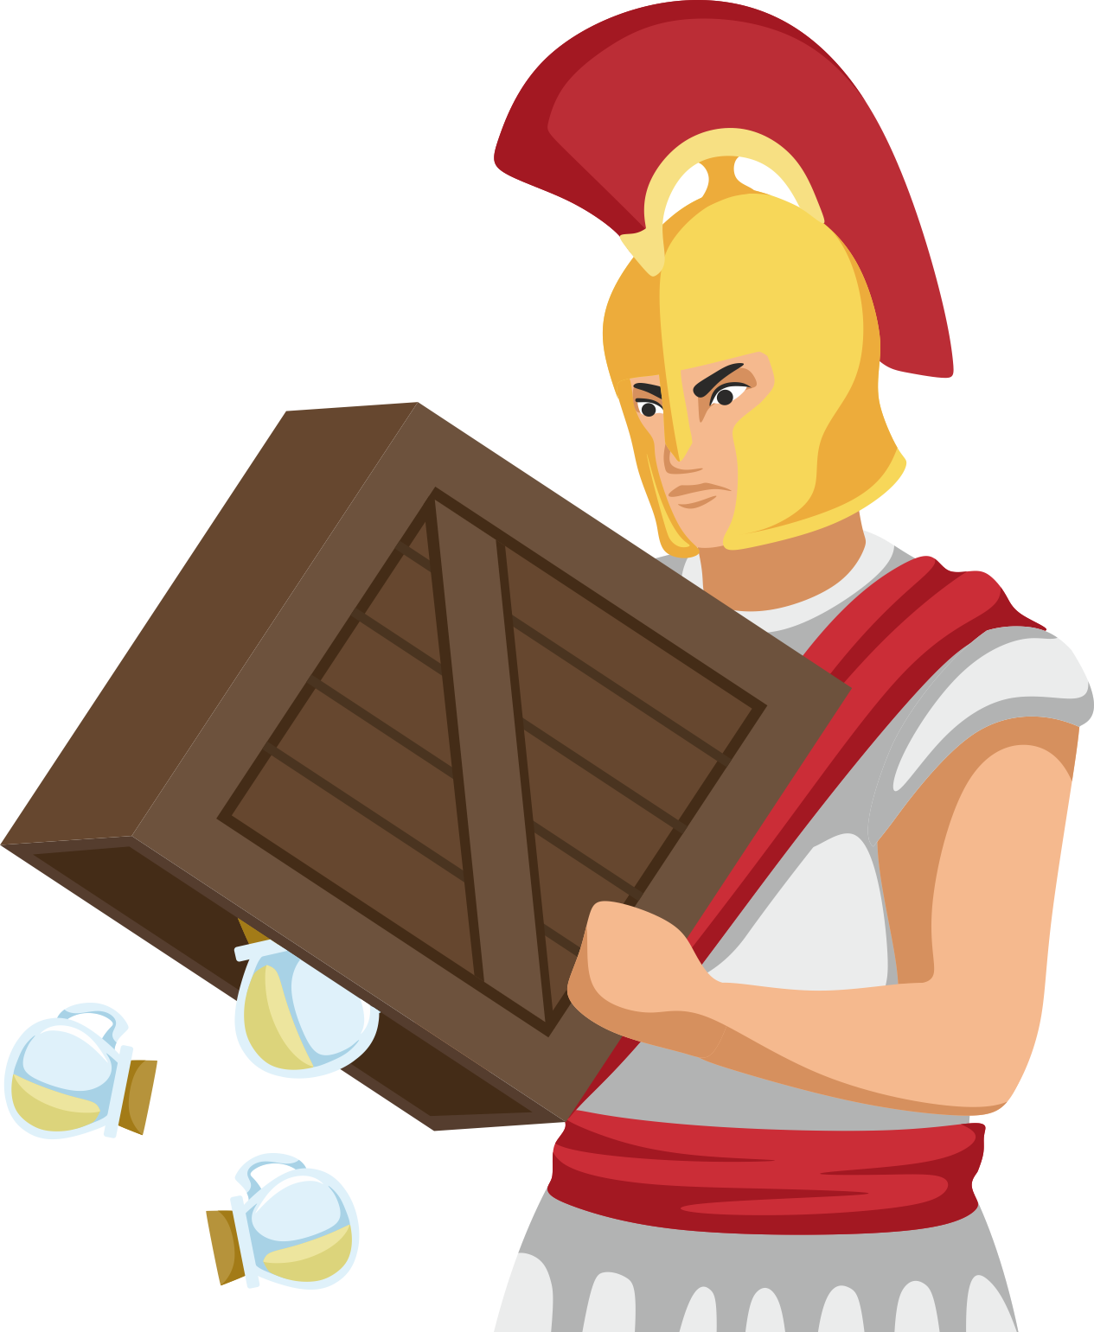
167 B.C.E
Oil desecrated. Art: © Gil Dekel.

Slide 14
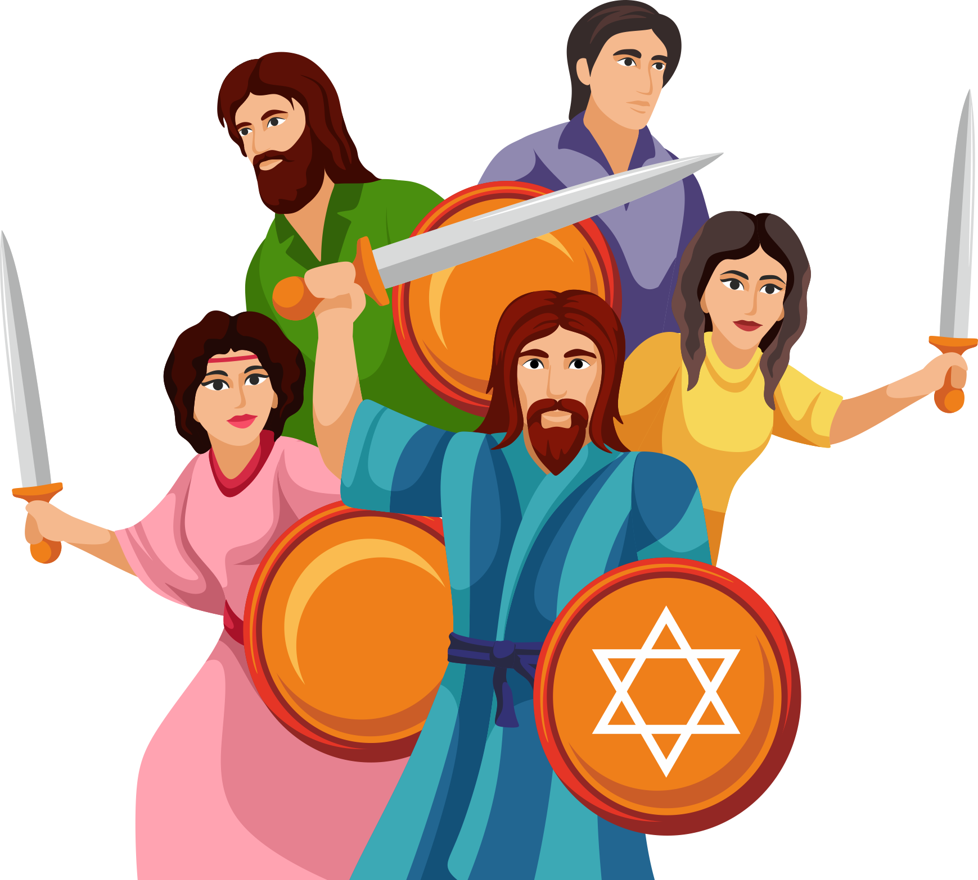
The MaCaBim המכבים fighting back.
166 BCE - 160 BCE. Art: © Natalie and Gil Dekel.

Slide 15
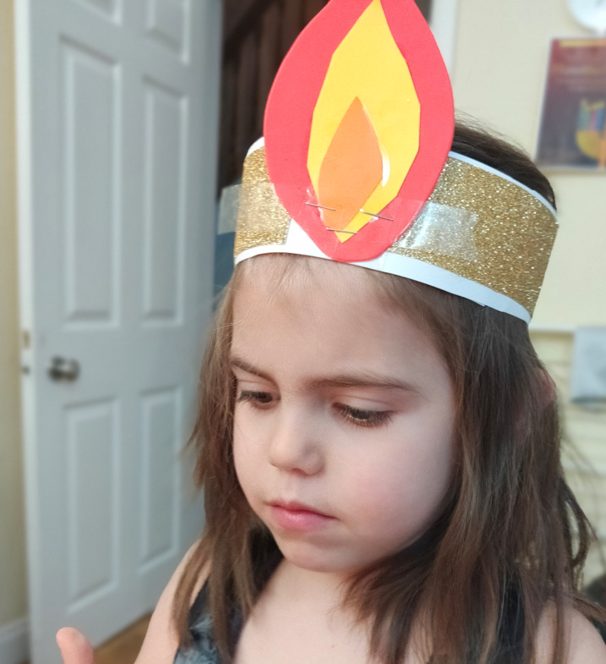
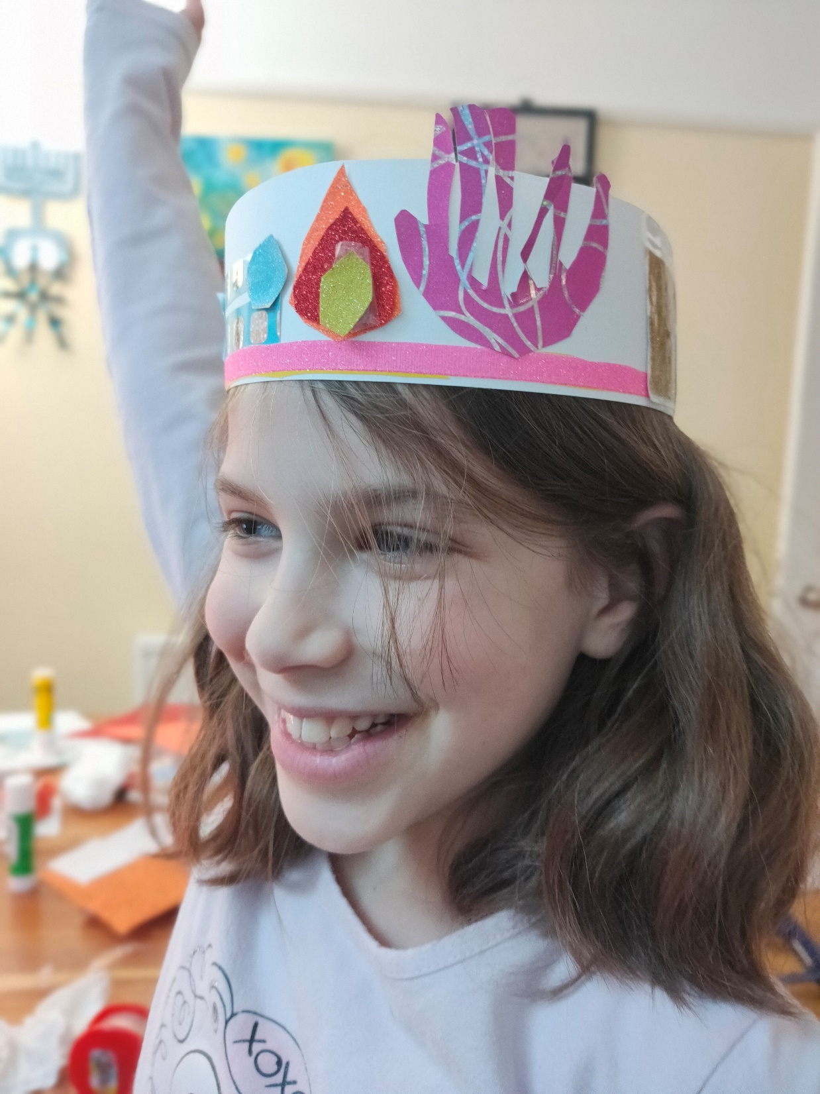
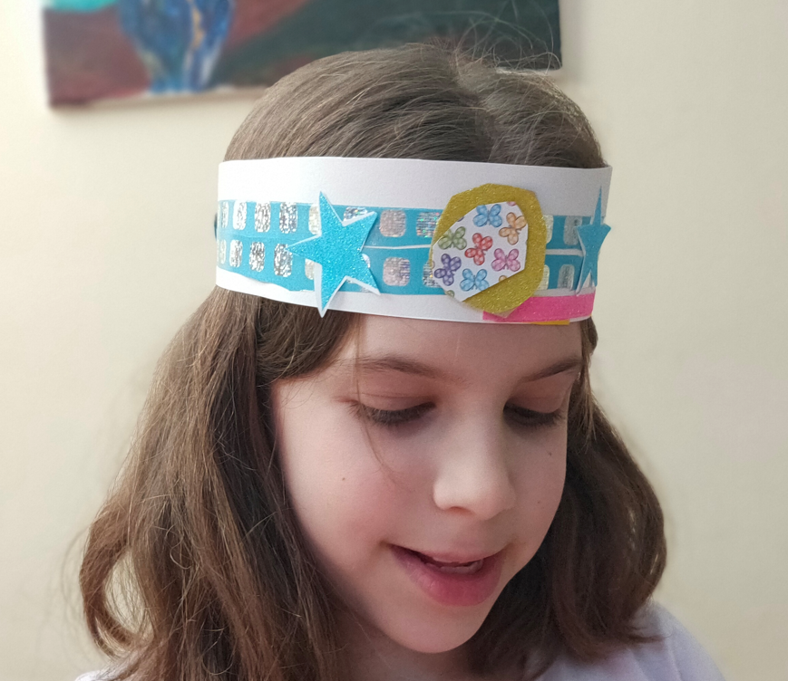
Art Activity
Yehudit HaMacabit had a humble crown. Make your own Hanuka paper crowns.
Make Hanukka paper crown… Photos: © Gil Dekel, 2021.

Slide 16
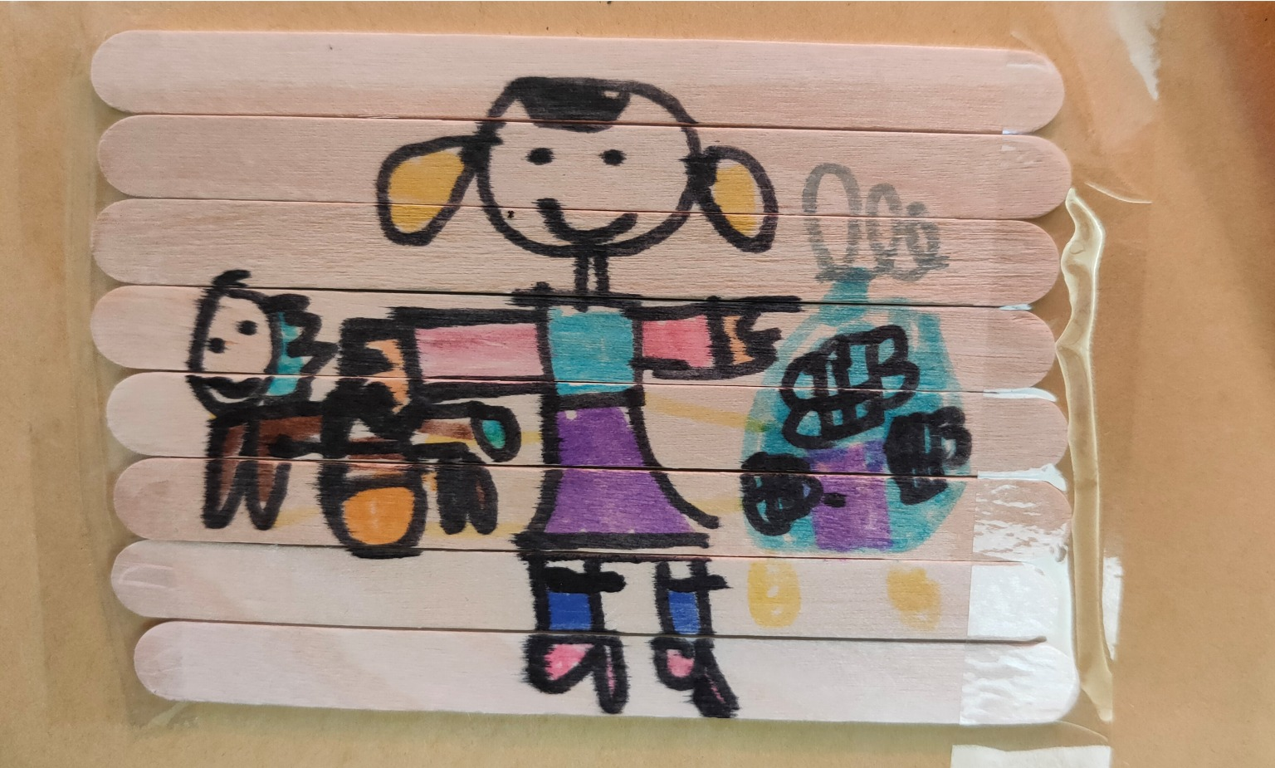
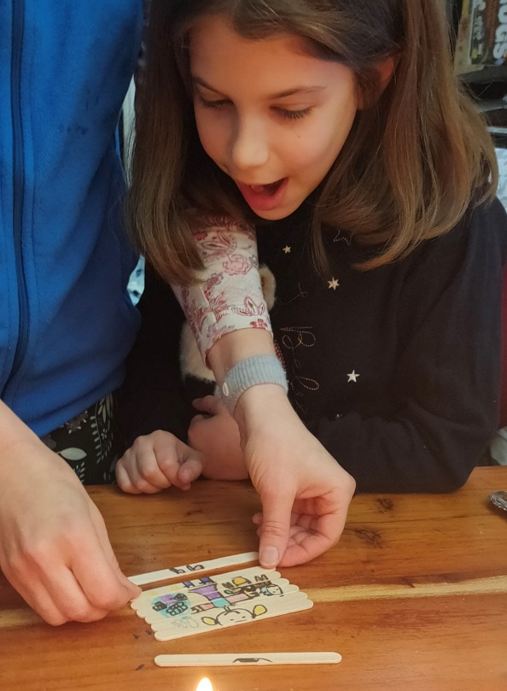
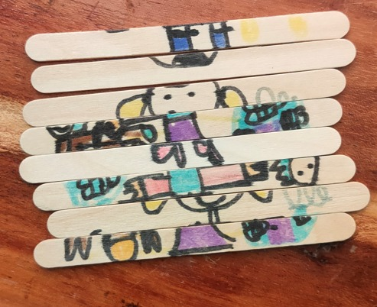
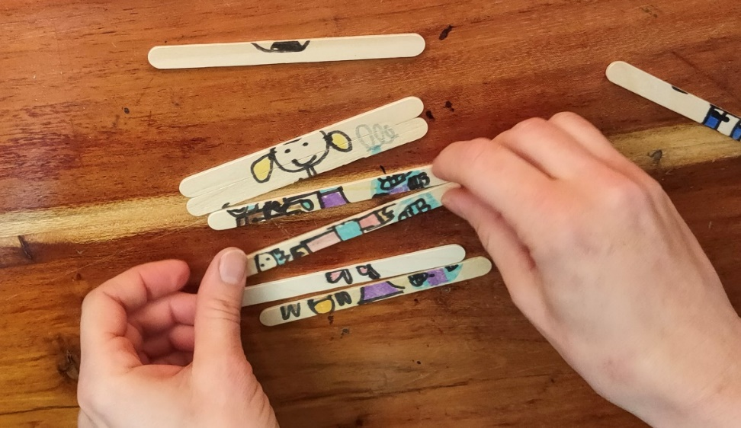
Art Activity
Make a puzzle from lolly sticks, with drawing of Macabim; or you can draw a Jerusalem princess… Photos: © Gil Dekel, 2021.

Slide 17
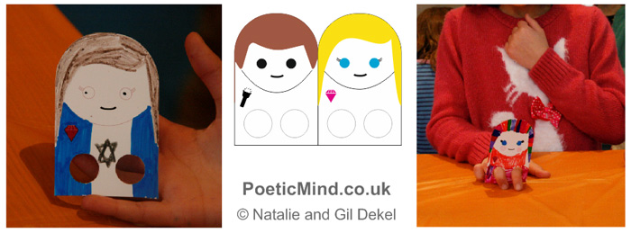
Art Activity
Template:
http://www.poeticmind.co.uk/wp-content/uploads/2013/12/Templates-Images-Hanuka.zip
Make Macabim paper puppets… The puppets can ‘dance’ to Hanuka songs. Download a template:
http://www.poeticmind.co.uk/wp-content/uploads/2013/12/Templates-Images-Hanuka.zip
Photos: © Gil Dekel.

Slide 18
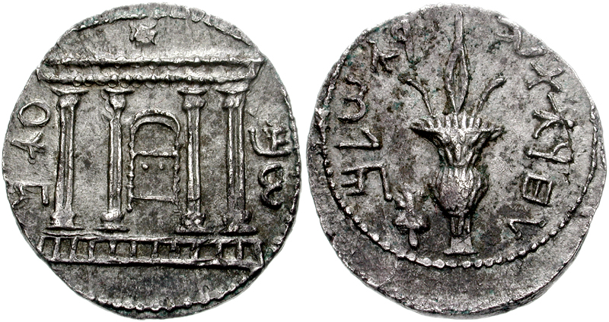
Coins from the time of Bar Cochva.
Photo: https://he.wikipedia.org/wiki/%D7%9E%D7%A8%D7%93_%D7%91%D7%A8_%D7%9B%D7%95%D7%9B%D7%91%D7%90

Slide 19
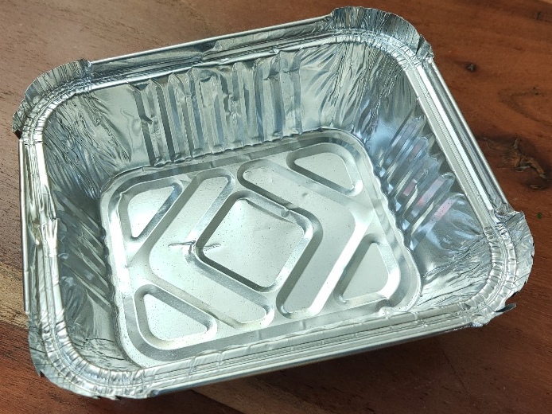
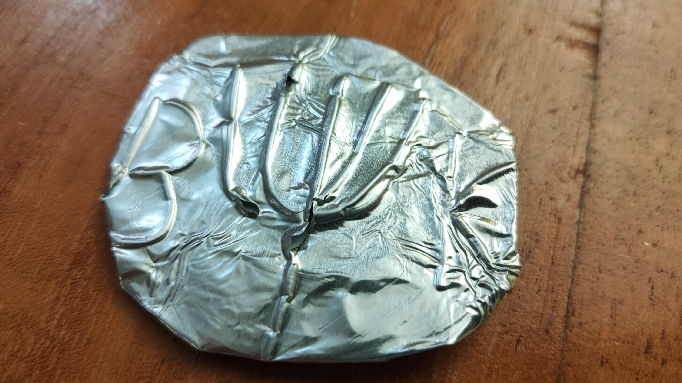
Art Activity
Make Bar Kochva coins from kitchen tin tray. Be careful as tin tray, once cut, is sharp. Create indent by drawing your design with a pen; then turn the tin around so the design is embossed. Wrap tin around a circle card. Photo: © Gil Dekel, 2021.

Slide 20
Macabim found one oil bottle in Beit-Hamikdash. Art: © Gil Dekel.

Slide 21
Temple ‘Beit Mikdash’ Menora. Art: © Gil Dekel.

Slide 22
8 days oil miracle. Art: © Gil Dekel.

Slide 23
Modern Menora in Jerusalem. Photo: Wikipedia Common / Oren Rozen.

Slide 24
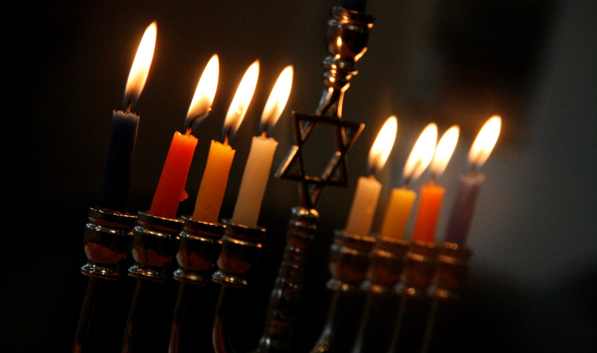
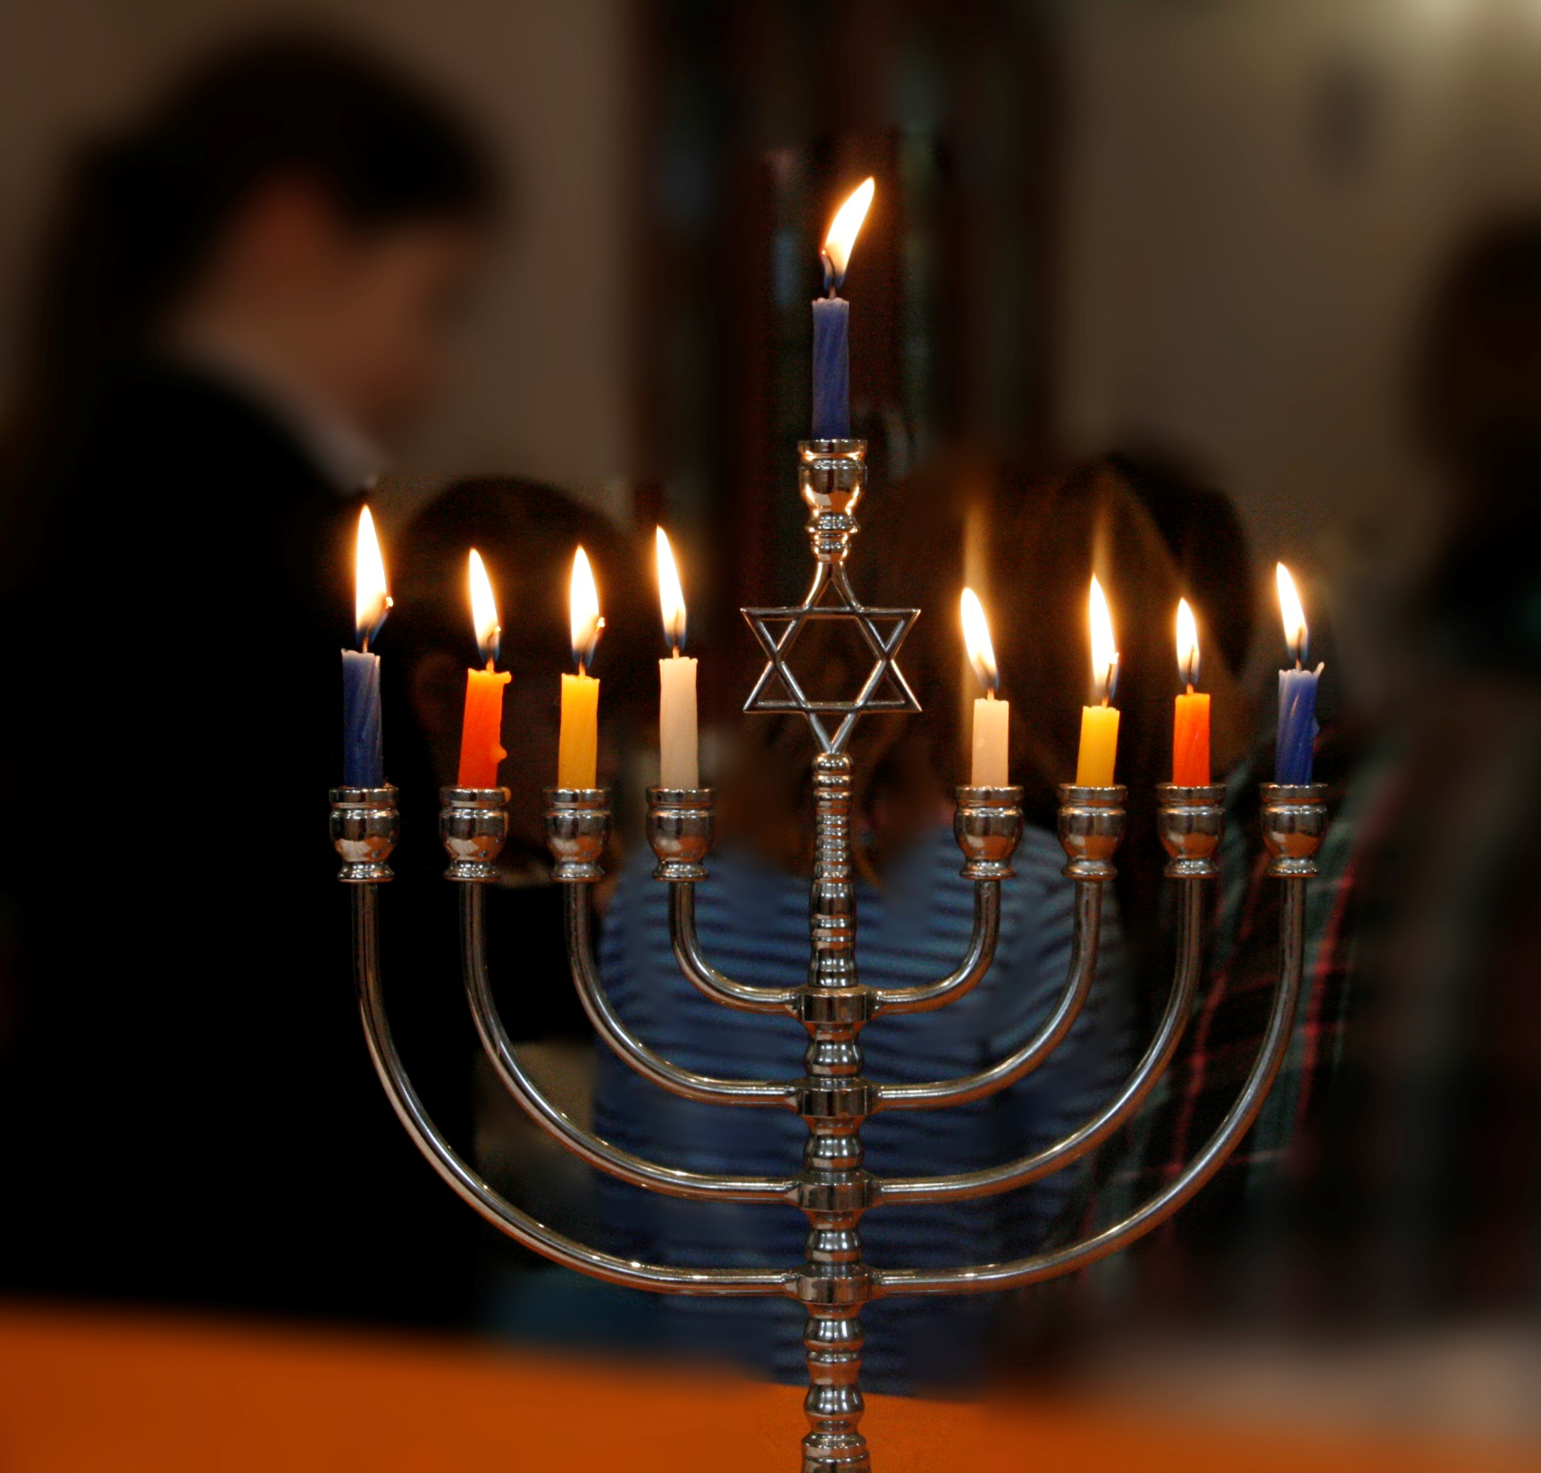
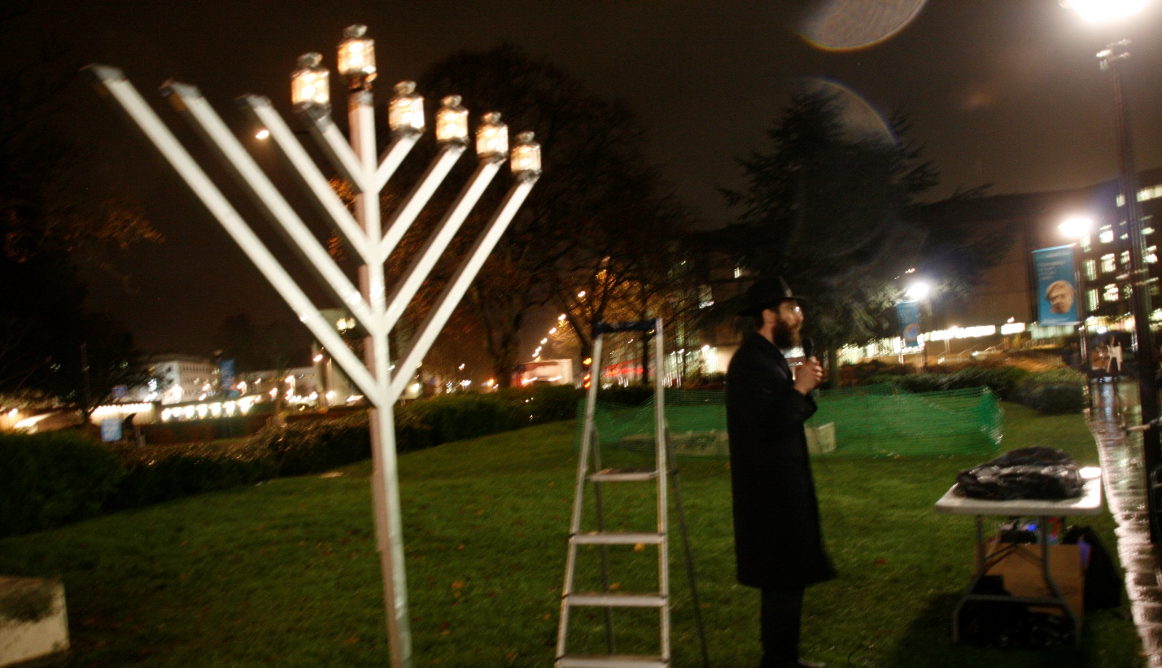
Modern HanuKiyas. Photos: Gil Dekel.

Slide 25
8
8 days
8 days miracle. Figure 8 represents infinity.

Slide 26
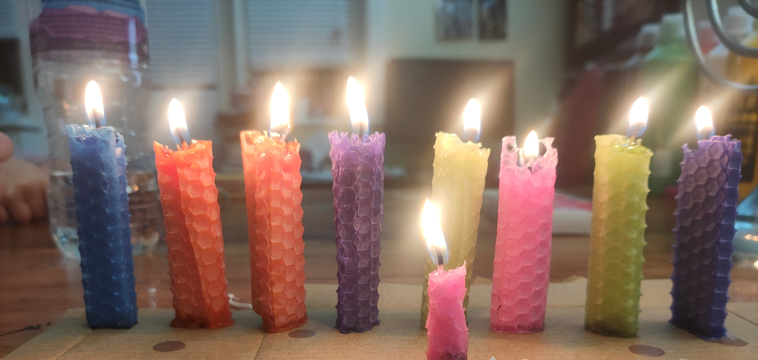
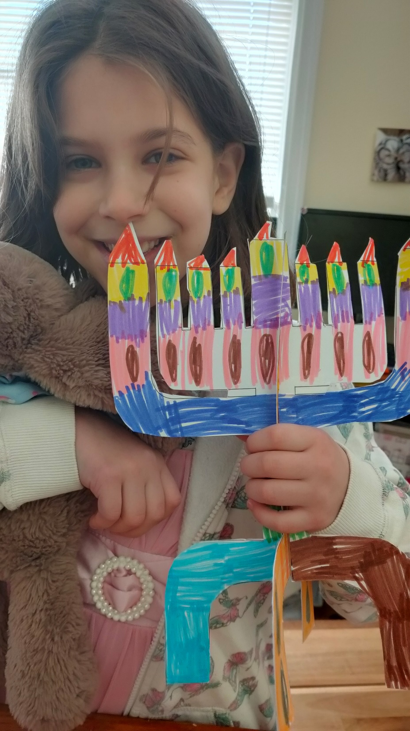
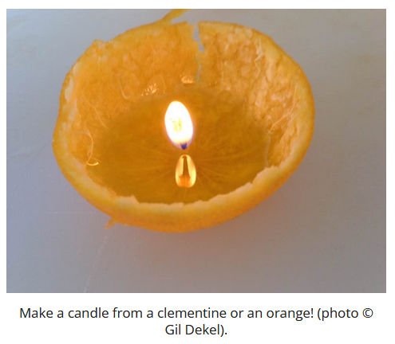
Art Activity
Make Menora, Hanukiya. Roll wax sheets, or make card model. Photos: © Gil Dekel, 2021.

Slide 27
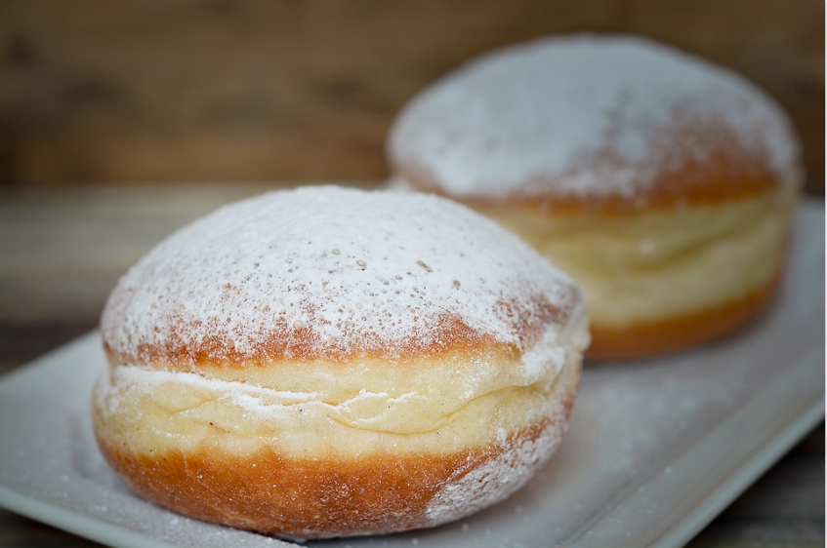
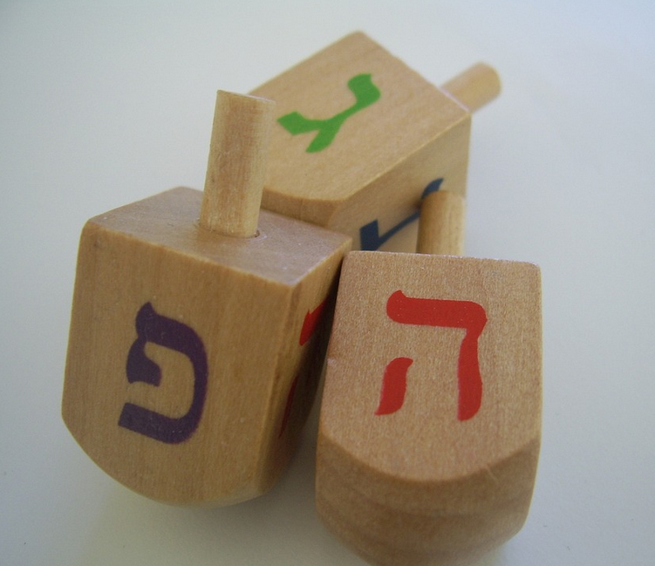
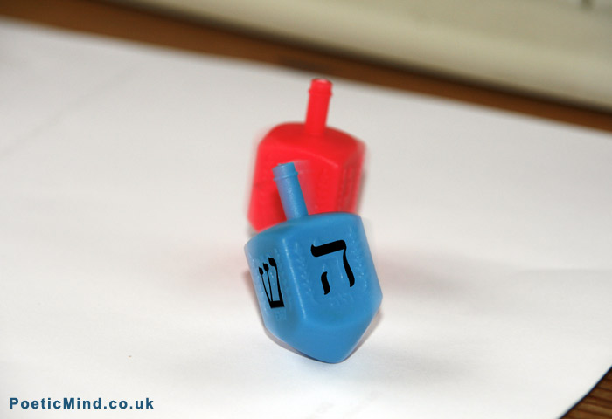
Sufganiya. Photo: Pezibear / pixabay.
Chocolate coin. Photo: Wikimedia Commons / Evan-Amos.
Svivons. Photo: Pixabay / PublicDomainPictures.
Svivon. Photo: Gil Dekel.

Slide 28
Art Activity
Make Svivon, spinning tops, from bottles’ caps… You can also paint over them. Photos: © Gil Dekel, 2021.

Slide 29
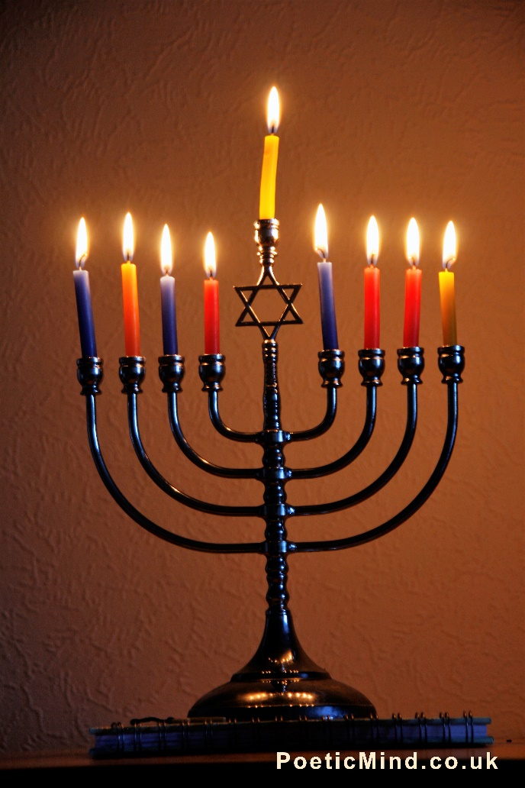
Al HaNisim miracles
Al HaNiflaot wonders
Miracles ניסים - nature’s functions are miraculous.
Wonders נפלאות – our ability, as humans, to appreciate the miracles.
Photo: © Gil Dekel.

Slide 30
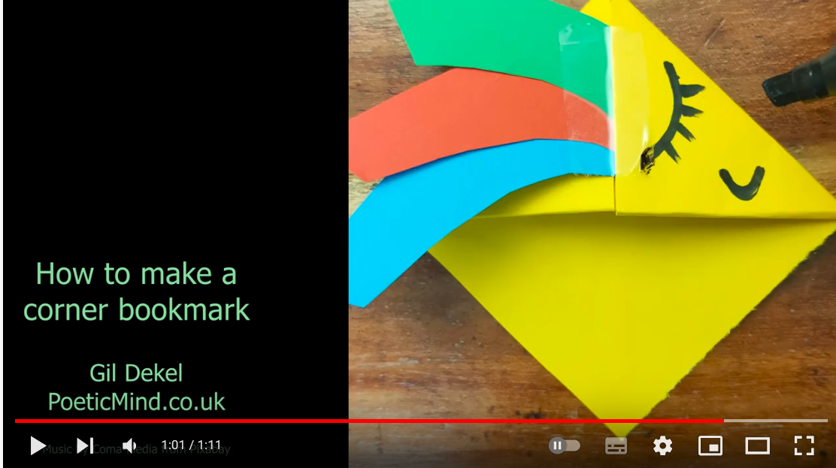
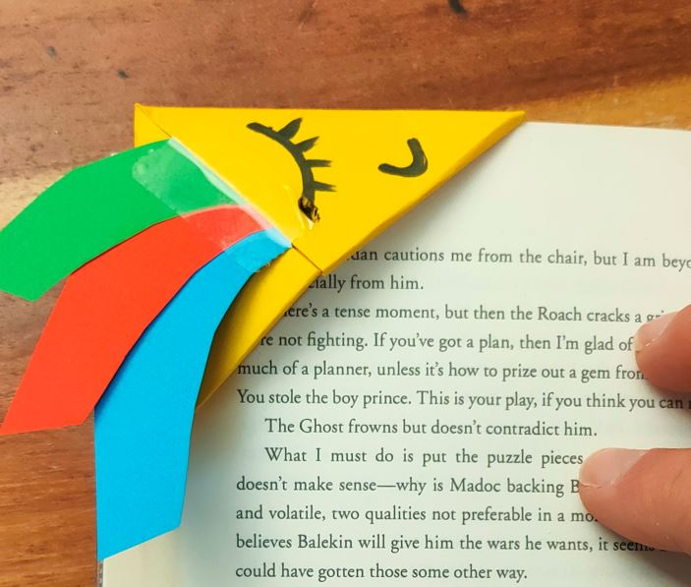
Art Activity
Festival of Light - make a bookmark in the theme of light.
We created a rainbow sun creature bookmark... Watch video for step-by-step guide.
https://youtu.be/Kg3-B3jZXw8

Slide 31
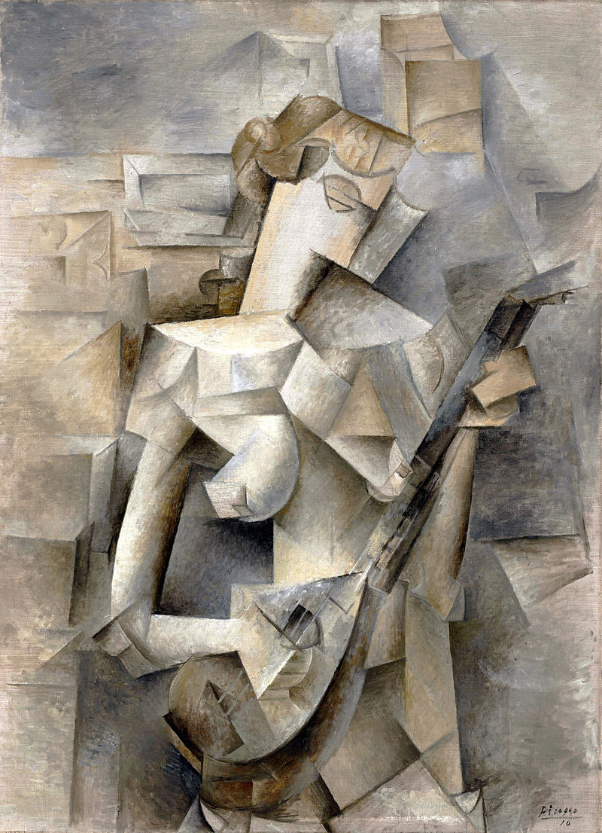
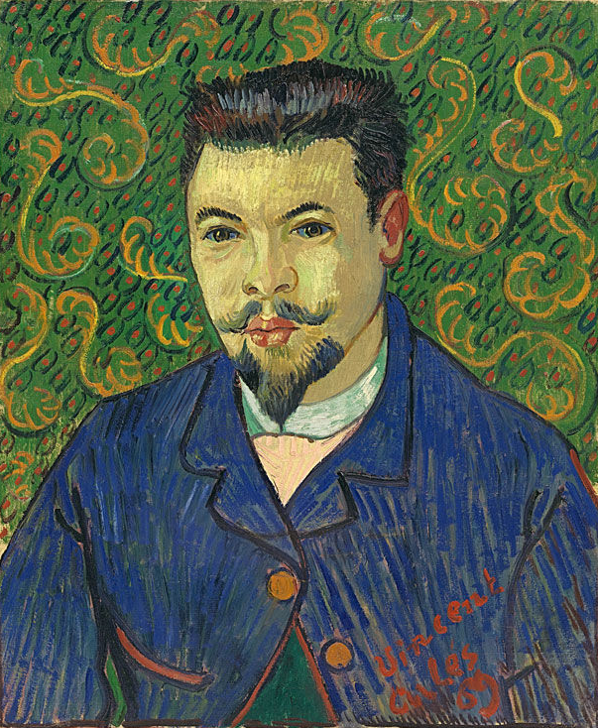
Draw the Macabim in the style of famous artists (or in any other style really; see below, Yehudut Macabit)...
Art Activity
Portrait of Dr Felix Rey, Vincent van Gogh, Arles, January 1889.
Image in public domain: https://en.wikipedia.org/wiki/Vincent_van_Gogh
Girl with a Mandolin (Fanny Tellier), Pablo Picasso, 1910 oil on canvas, 100.3 x 73.6 cm, Museum of Modern Art, New York. Image in public domain: https://en.wikipedia.org/wiki/Pablo_Picasso

Slide 32
How to use this resource:
Some slides illustrate the Hanuka story, and other slides provide art activities.
Permission to use:
You can use this resource for educational, non-commercial purpose. Credit: © Gil Dekel www.PoeticMind.co.uk
Drawing ‘Hanukiya’ by Nicole Dekel. Used with the artist’s permission.

Slide 34
Biomimicry
https://www.bbc.co.uk/programmes/w13xttw7
Learn comma – walk/speak, then stop when comma in sentence

Slide 36
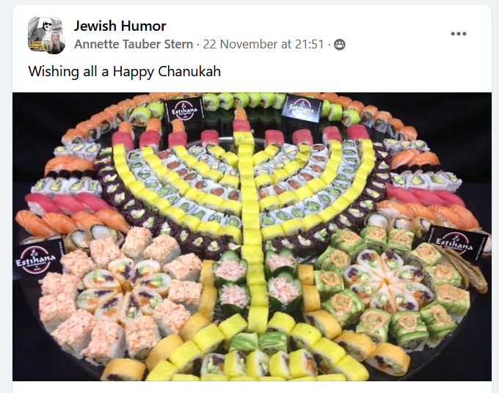

Slide 37
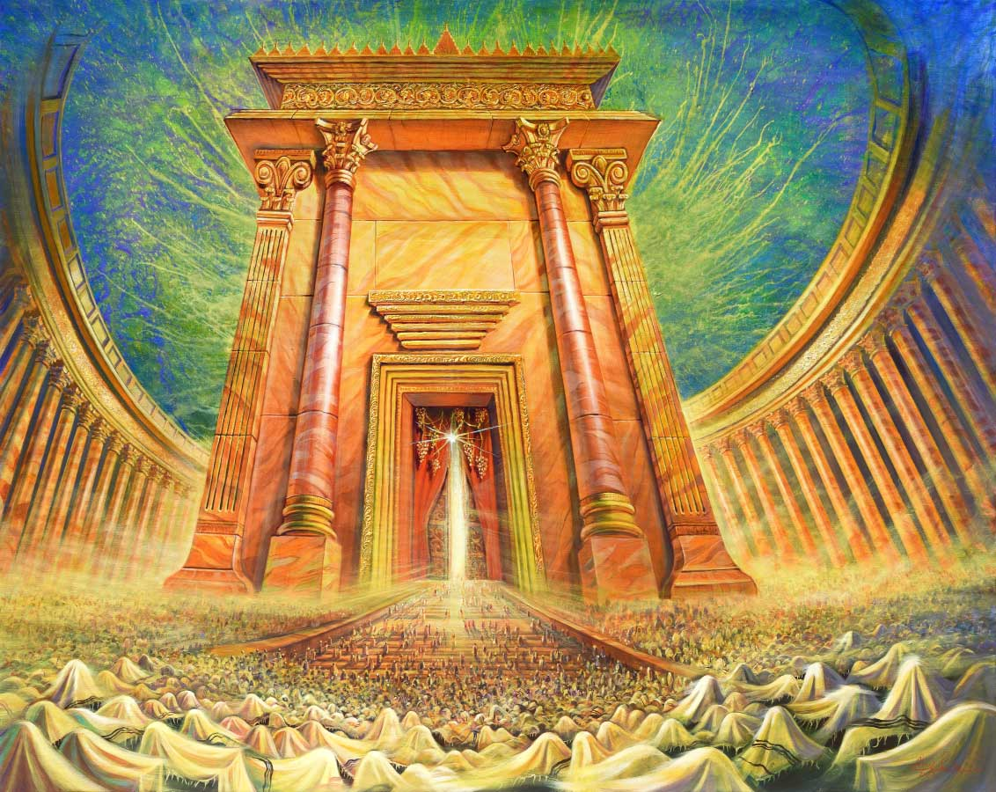
Rebuild the temple
Painting ‘Rebuilt Temple welcomes the sons of Israel’ by Alex Levin https://artlevin.com Used with the artist’s permission.

Slide 38
https://www.poeticmind.co.uk/sages/hanukah-story-and-art-activities-for-kids-age-7-12/

Slide 39
The Maccabeats - All About That Neis - Hanukkah
https://youtu.be/2wi1H3UnKhk
The Chanukah Shaboom! Special - Great Miracles
https://www.youtube.com/watch?v=lvUmL5TOP74
Six13 - Bohemian Chanukah (a Queen adaptation)
https://www.youtube.com/watch?v=9P30ckBf1wk
BBC The Jewish Story of Hanukkah | Religions of the World
https://www.youtube.com/watch?v=zsXQfCeMHs8
The Story of Hanukkah
https://youtu.be/IlJ_5Tyu5iA

Slide 40
The Maccabeats - Candlelight - Hanukkah
https://www.youtube.com/watch?v=qSJCSR4MuhU

Slide 41
END

Slide 42
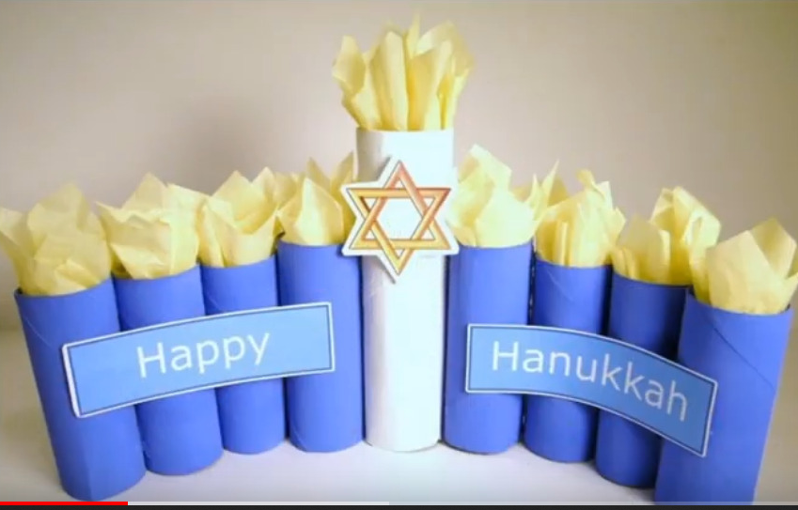

Slide 43
Jewish second temple, Jerusalem
Temple ‘Beit Mikdash’ Photo: © Gil Dekel
Image © Gil Dekel

Slide 44
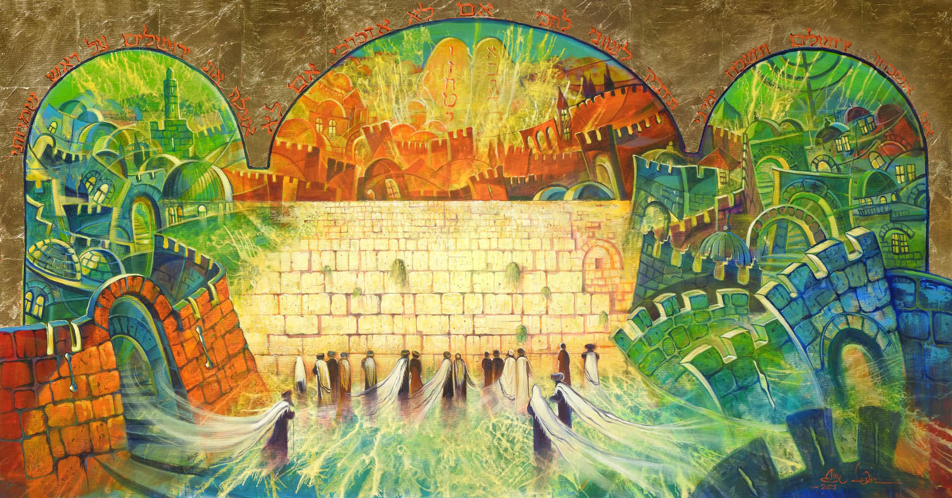
Jerusalem. Painting ‘Jerusalem – the Glory of Zion’ by Alex Levin https://artlevin.com Used with the artist’s permission.

Slide 46
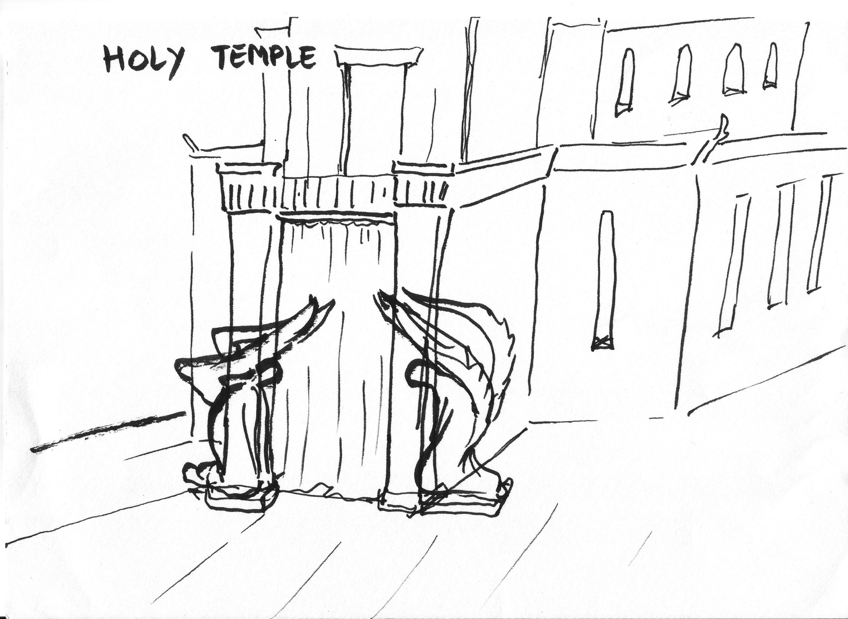

Slide 47
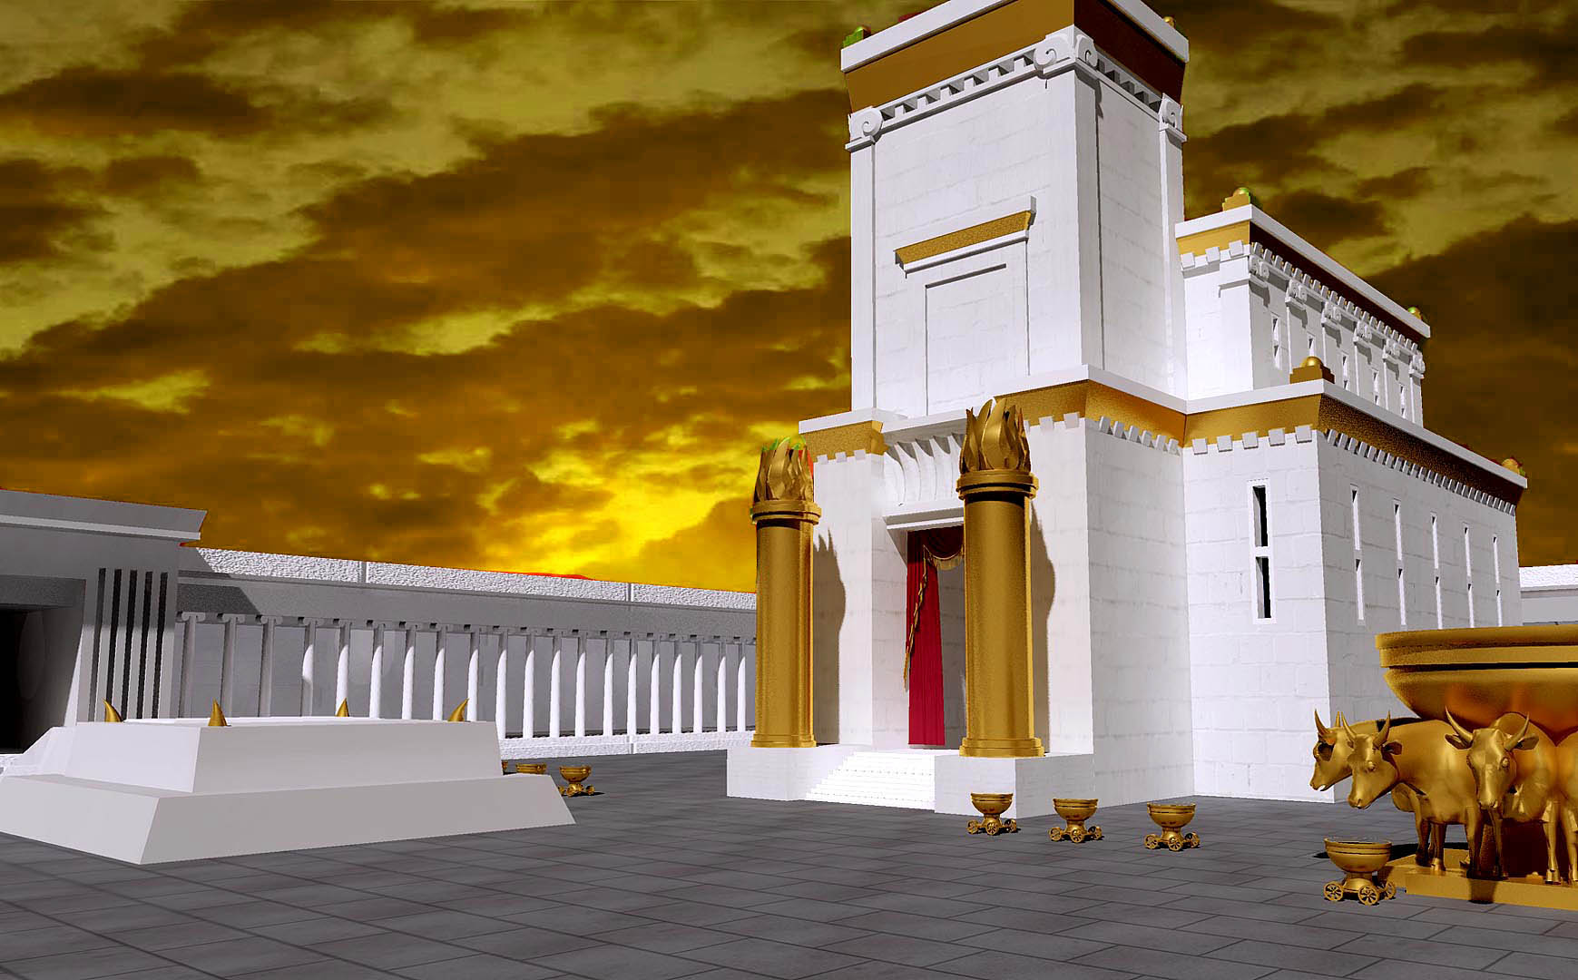
Temple ‘Beit Mikdash’ Photo: Wikipedia Common / Johnreve. Edited by Gil Dekel

Slide 48
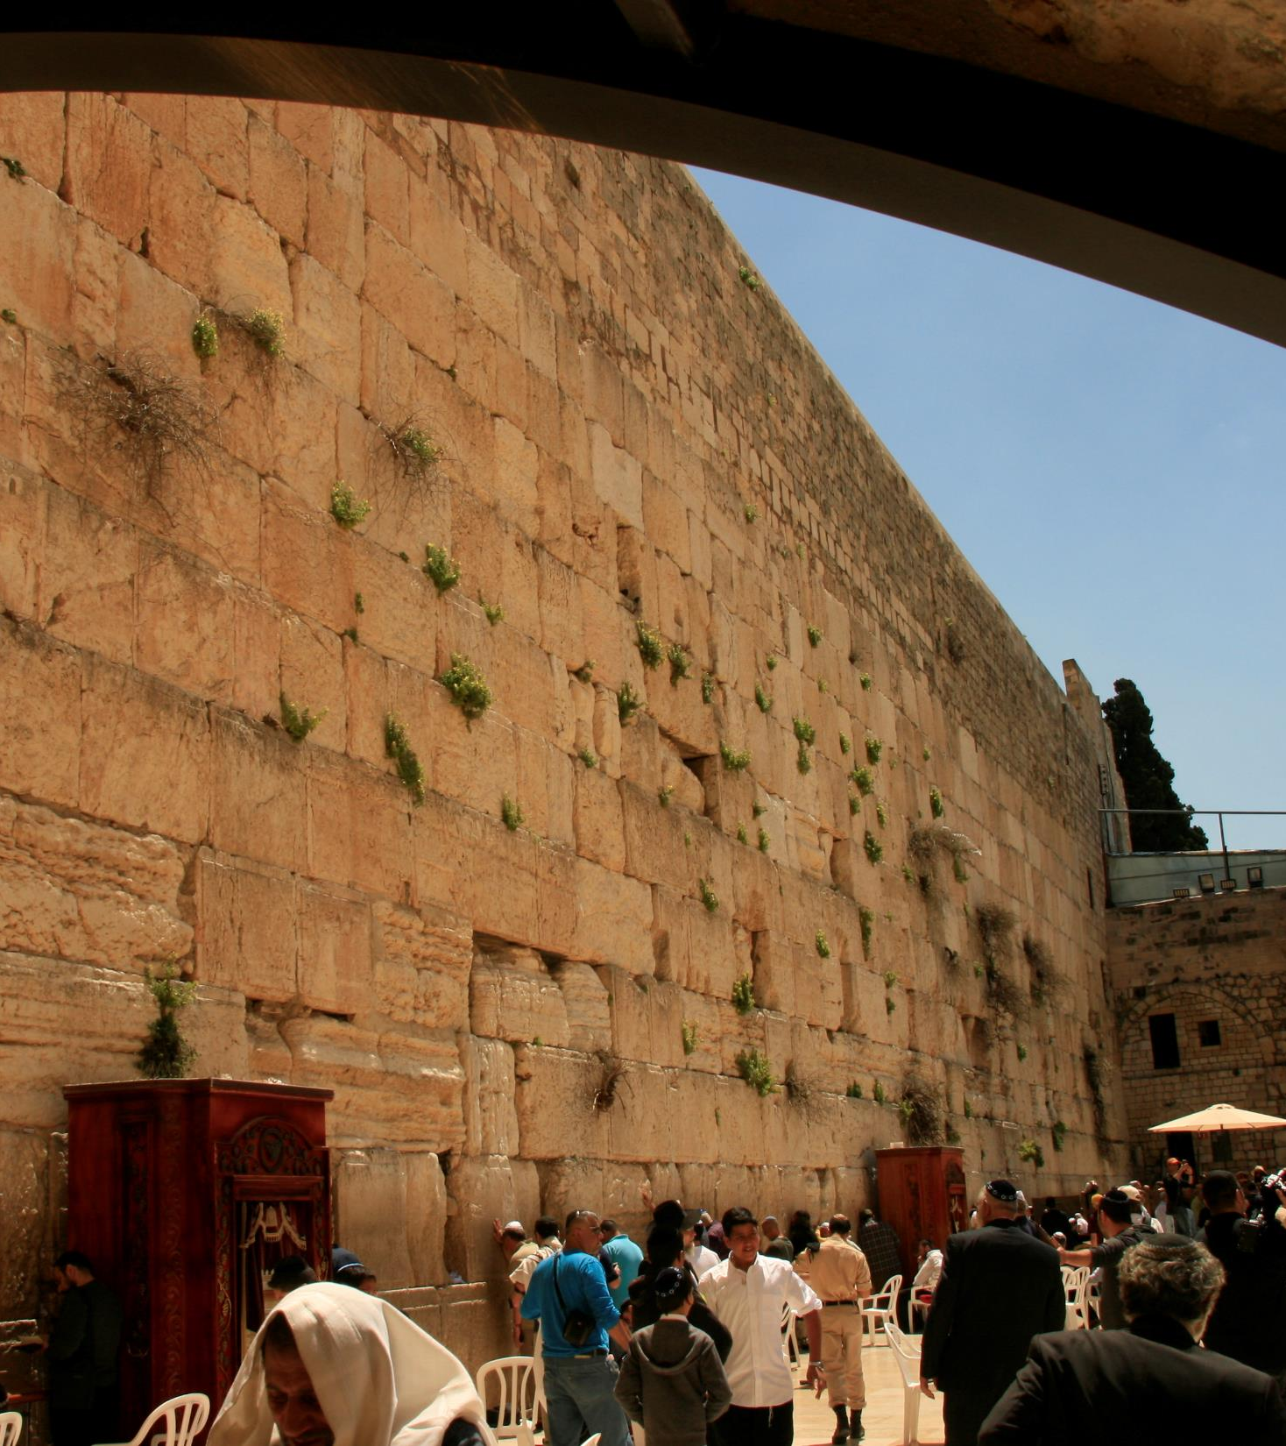
Jerusalem. Photos: © Gil Dekel, 2019

Slide 49
Temple ‘Beit Mikdash’ Photo: wikiopedia https://upload.wikimedia.org/wikipedia/commons/9/9b/Jerusalem_Modell_BW_3.JPG

Slide 50
Temple ‘Beit Mikdash’ Photo: https://www.ynet.co.il/articles/0,7340,L-4855440,00.html 2-11-2021

Slide 51
המשכן שימש כבית מקדש זמני, לפני בניינו במקום המיועד לו בירושלים. שמו הנוסף של המשכן הוא "אהל מועד":
https://he.wikipedia.org/wiki/%D7%91%D7%99%D7%AA_%D7%94%D7%9E%D7%A7%D7%93%D7%A9#/media/%D7%A7%D7%95%D7%91%D7%A5:Bible_primer,_Old_Testament,_for_use_in_the_primary_department_of_Sunday_schools_(1919)_(14595443098).jpg

Slide 52
Jerusalem Menora. Photo: © Gil Dekel, 2019

Slide 53
King Shlomo opens the First Temple ‘Beit Mikdash’. Painting:
James Tissot via wikipedia https://he.wikipedia.org/wiki/%D7%91%D7%99%D7%AA_%D7%94%D7%9E%D7%A7%D7%93%D7%A9#/media/%D7%A7%D7%95%D7%91%D7%A5:Tissot_Solomon_Dedicates_the_Temple_at_Jerusalem.jpg

